Slide 1


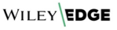
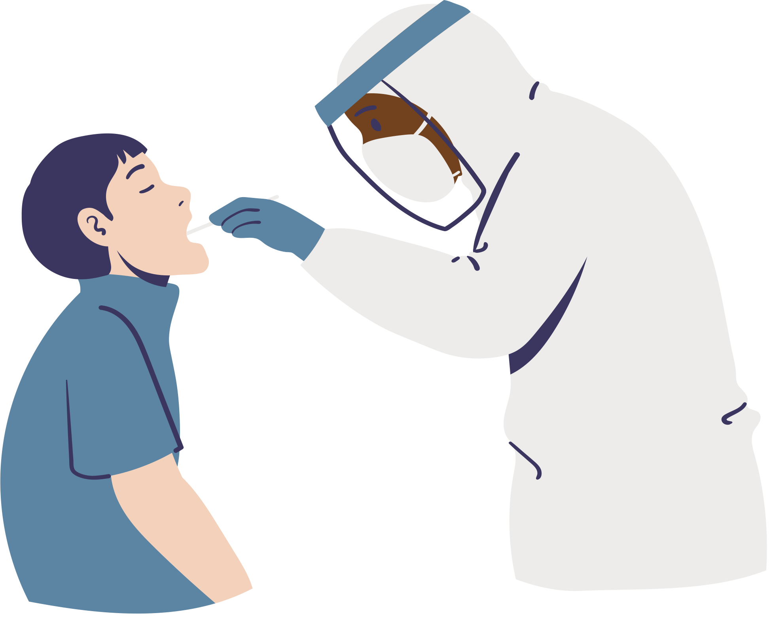

PROTECT SYSTEM
Sarah Almatrooshi
Afnan Alhammadi

Slide 2



PROTECT YOURSELF
Protect Your Community
Our website is the official health platform for patients UAE in with government and private hospitals.
By helping users to find the nearest hospital for testing and providing a platform to register for test results.

Slide 3
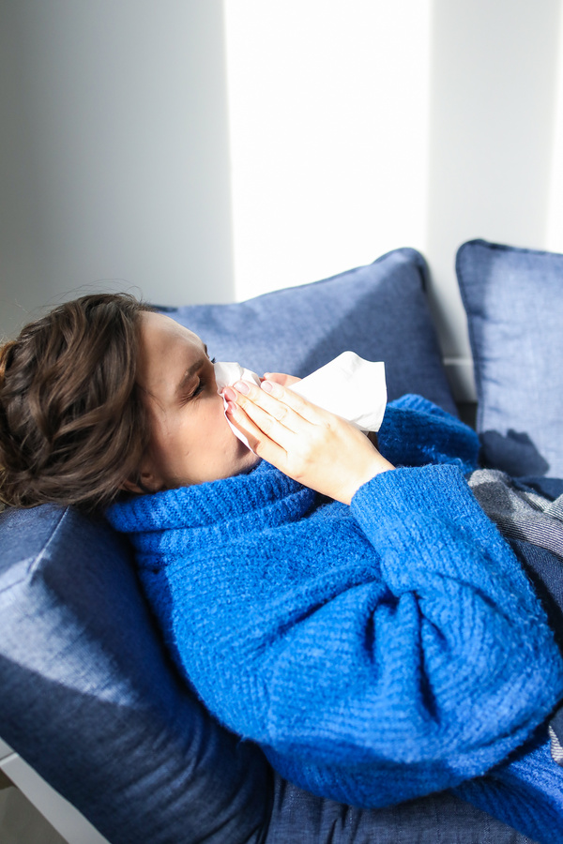
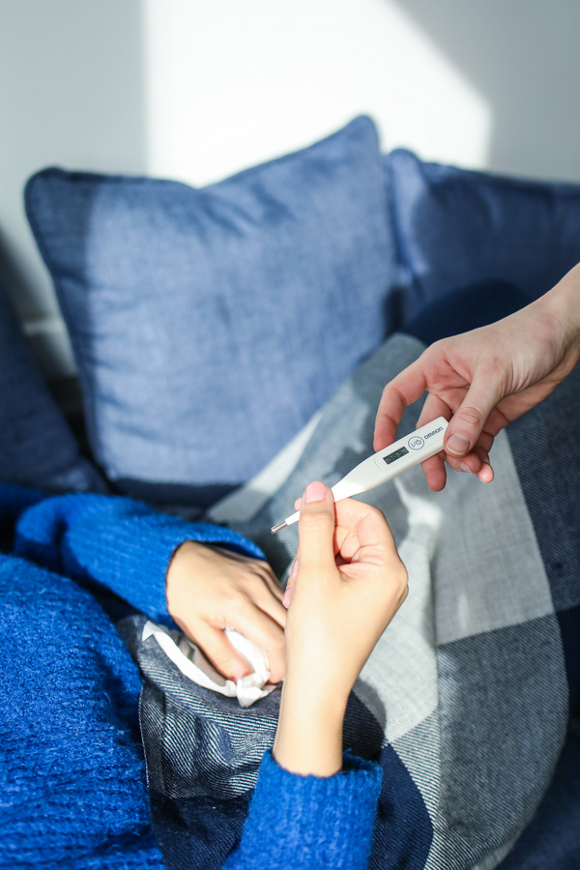
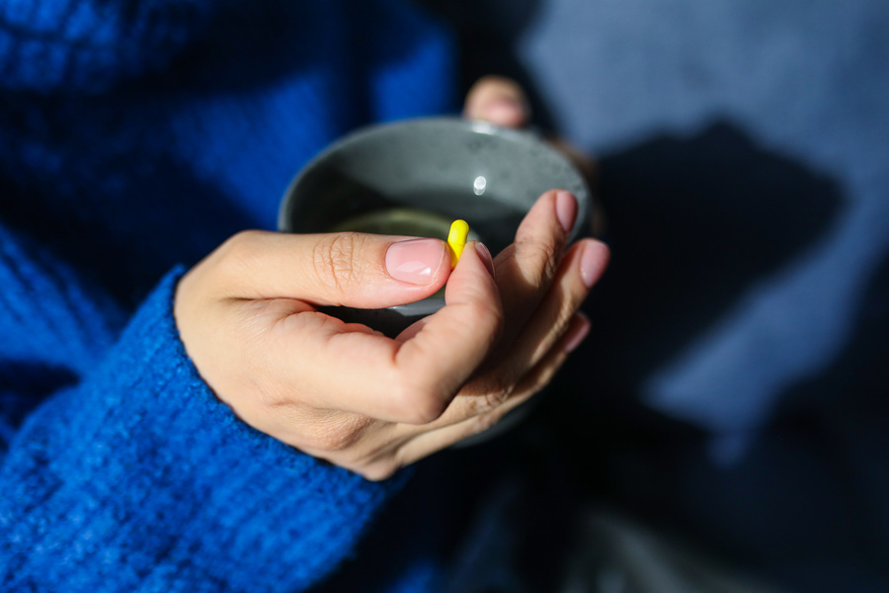
SYMPTOMS
Fever, cough
Muscle ache
Loss of taste or smell

Slide 4


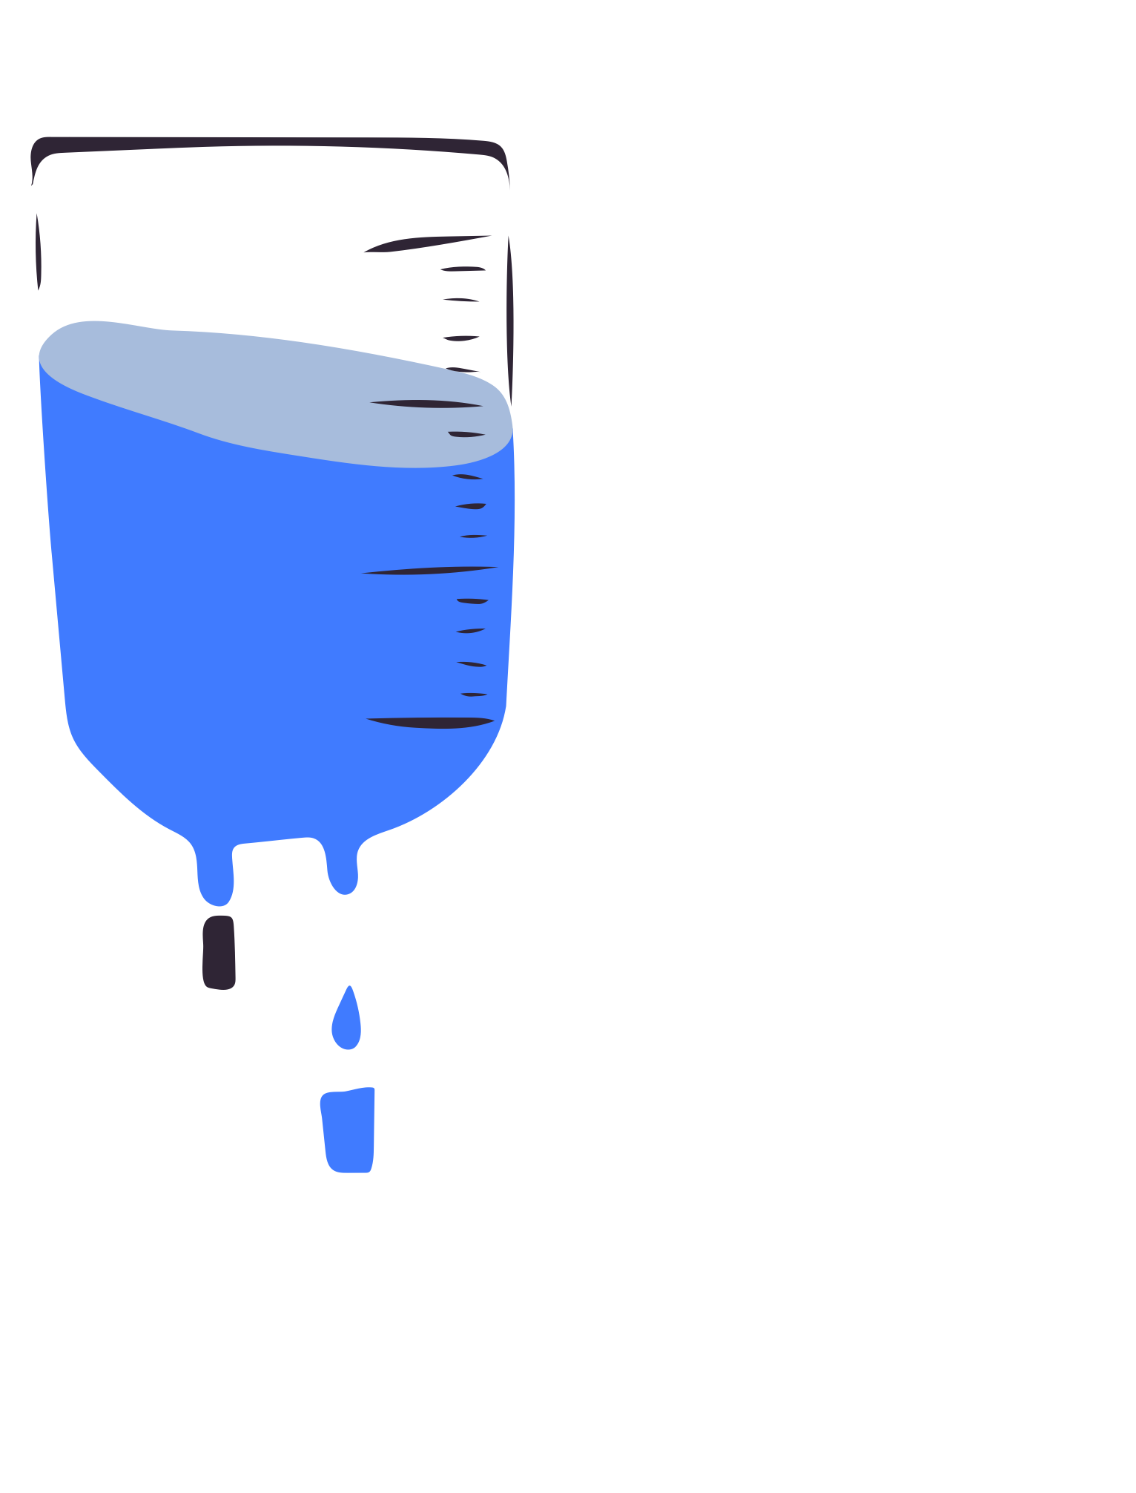

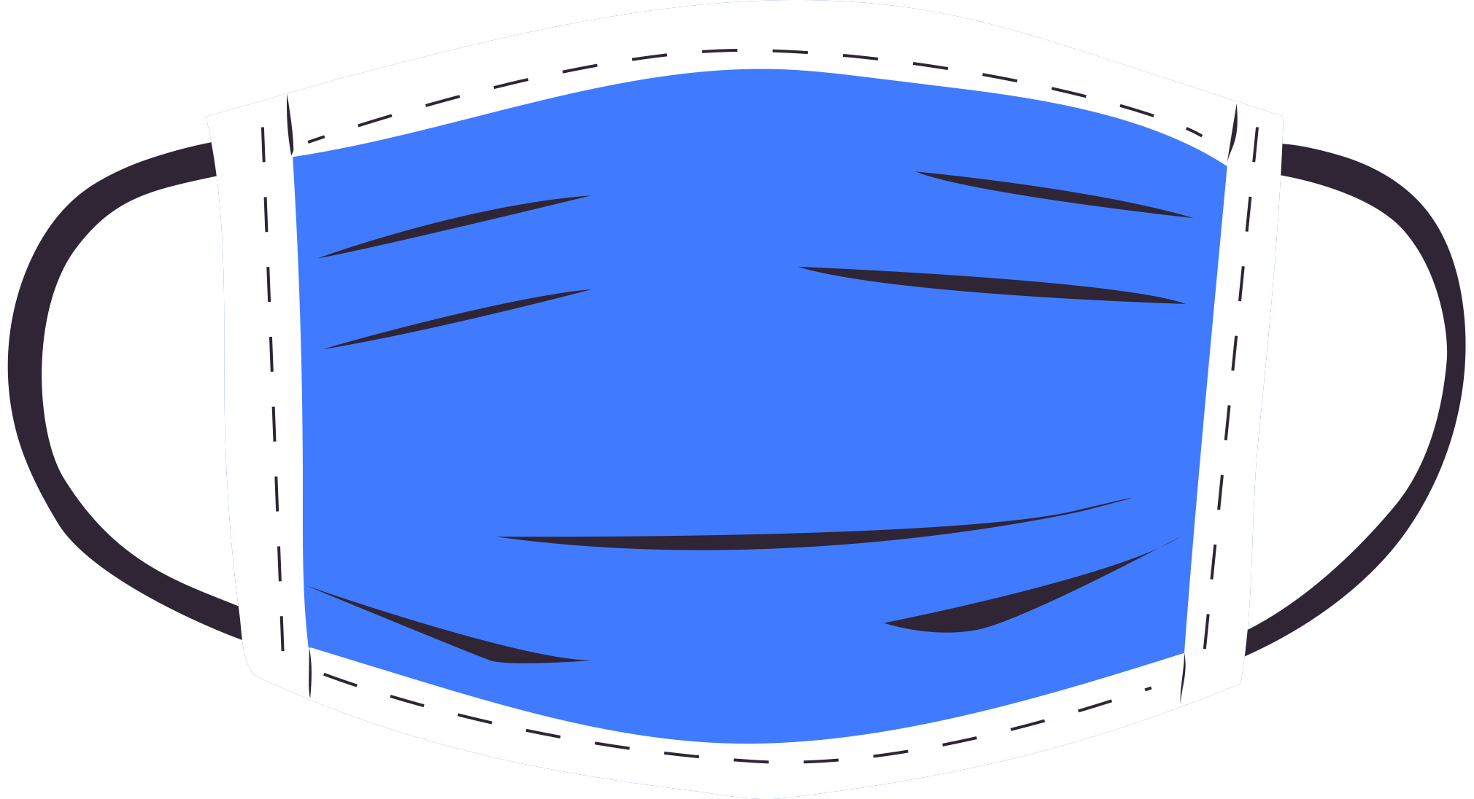

NEXT STEPS
What to Do If You Test positive
Track Your fever
Stay safe
sterilization
Rest
Use “ Protect System “

Slide 5



TECHNOLOGY STACK
Backend: Java with Spring Boot
Database: MySQL
Frontend: visual studio

Slide 6
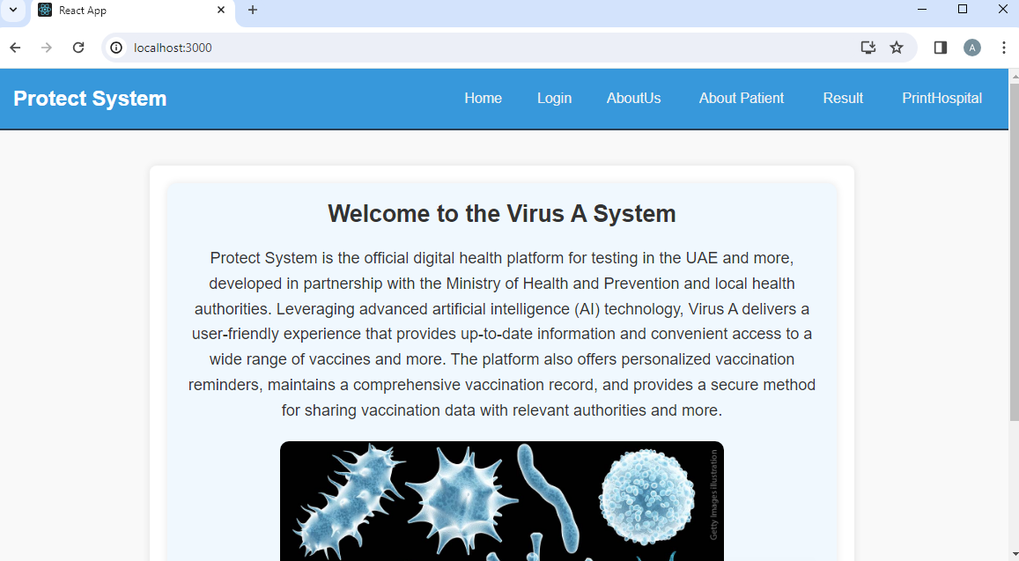

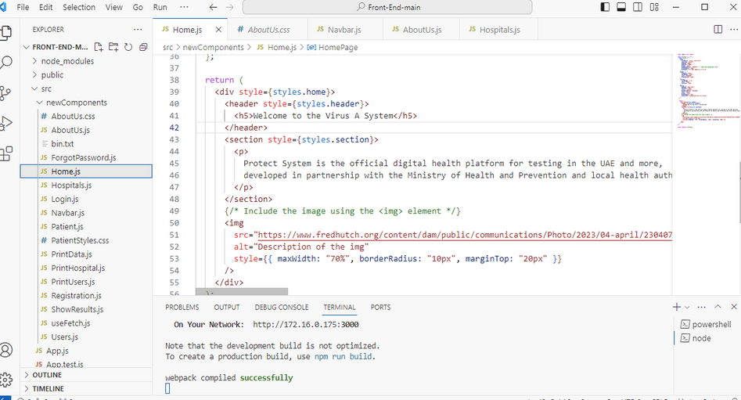
Home Page

Slide 7
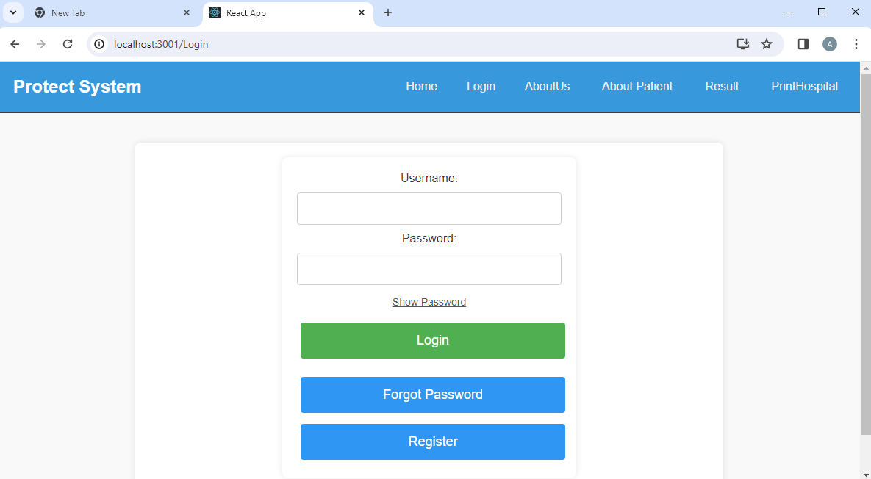
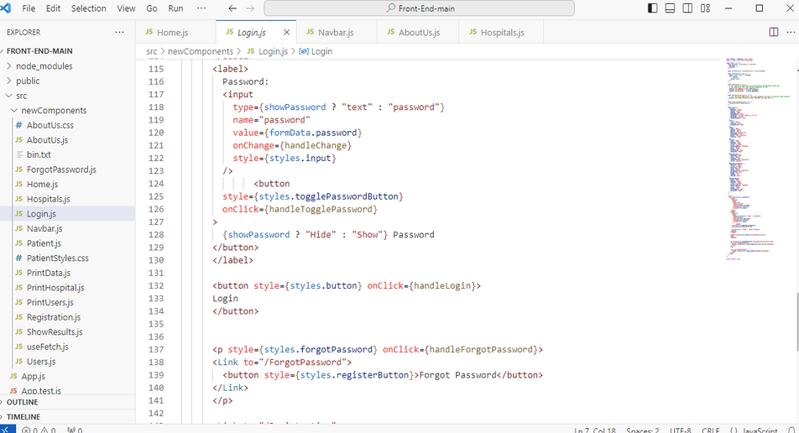
Login Page

Slide 8
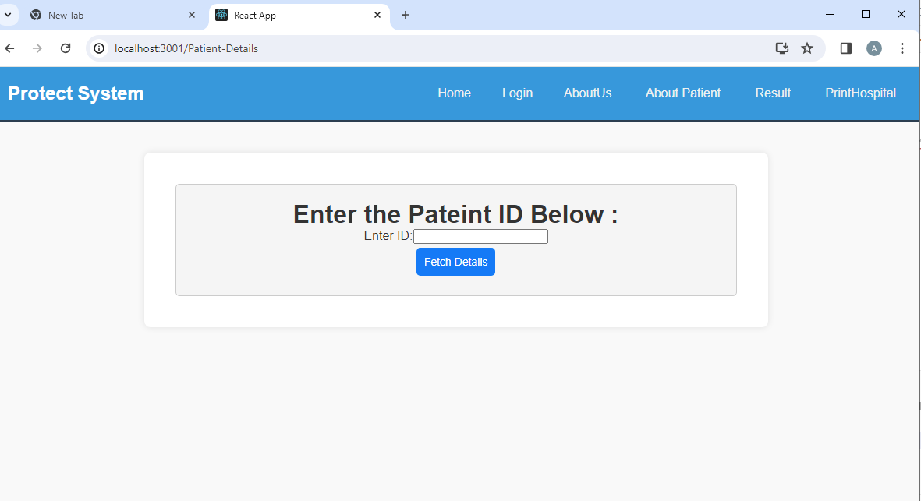
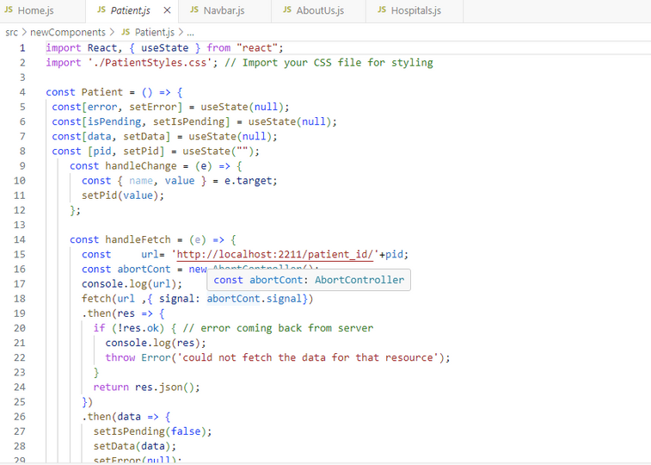
About Patient

Slide 9
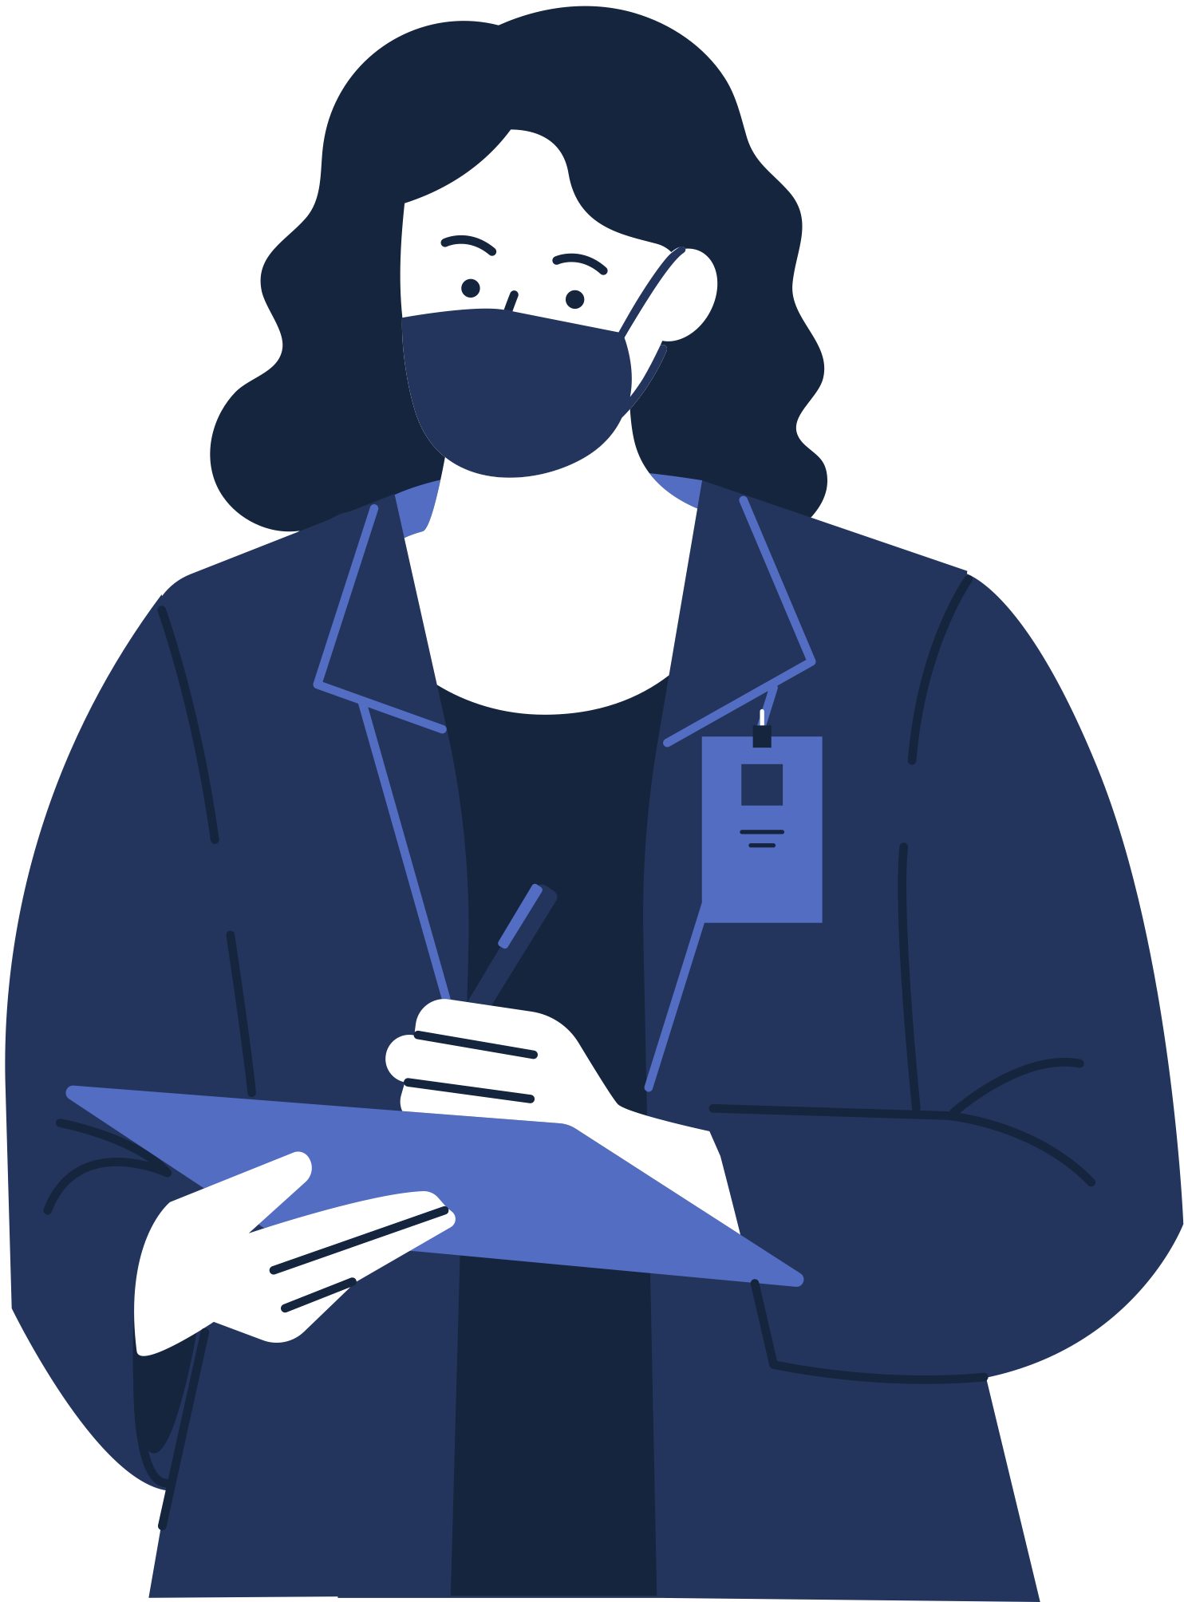
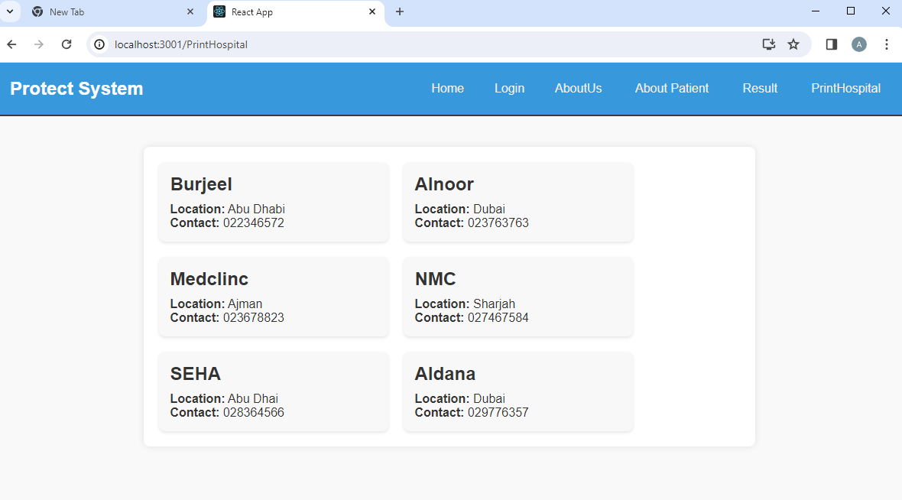
FOR MORE INFORMATION
Please contact the below hospitals

Slide 10
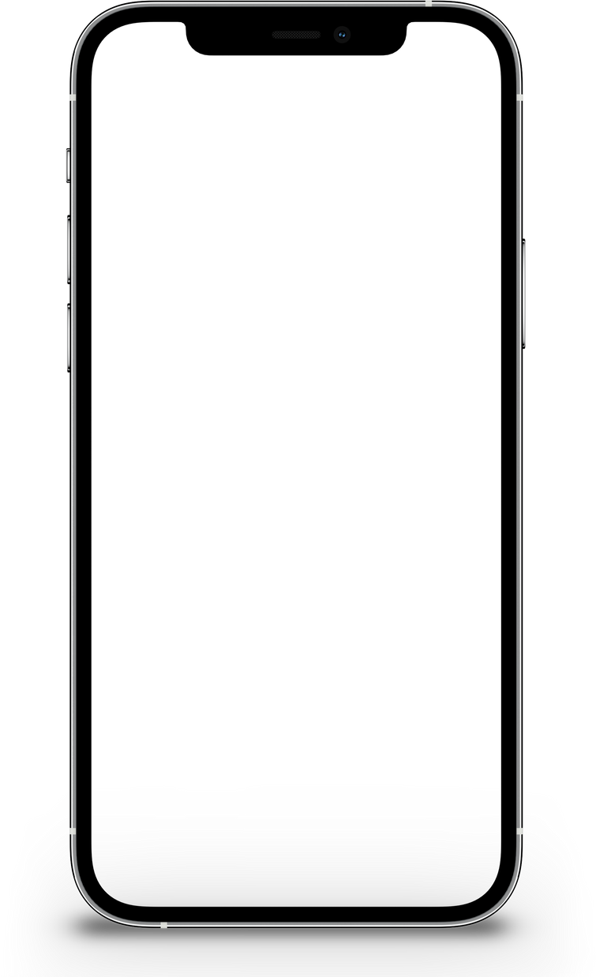
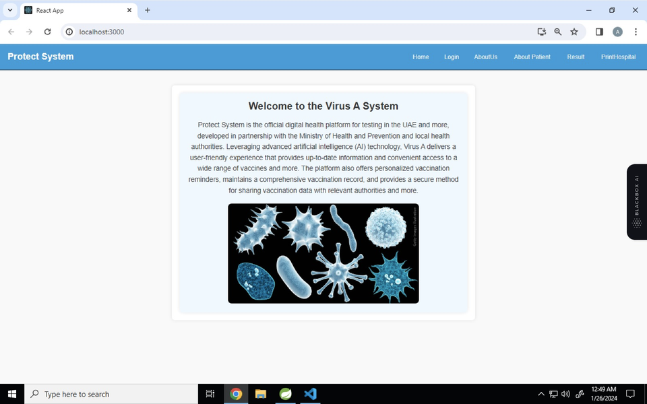

01
Mobile Application Integration
Feature Enhancements
02
Notification System
03
Real-time Appointment Scheduling

Slide 11
Conclusion
The Success in our project is a reflection of the real teamwork within our team and the support from our teacher.
We learned and applied coding in Java and SQL, overcoming challenges and achieving great results. This experience underscores the importance of collaboration, leaving us with newfound knowledge and a successful project to be proud of."

Slide 12


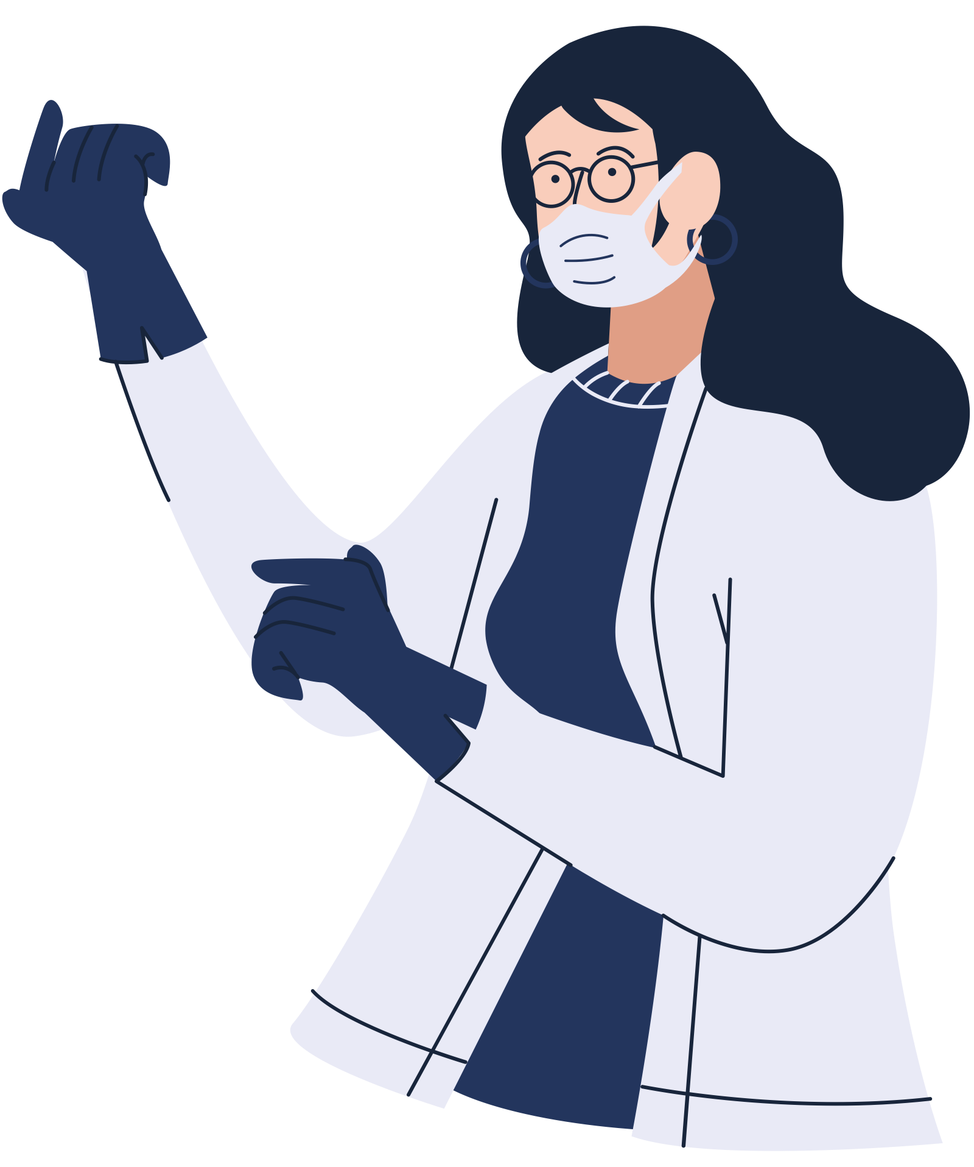

Thank you!
02 7077707
www.protectsystem.com
Sarah Almatrooshi - Afnan Alhammadi

